Slide 1

Faculty System Management.
Team: 😐
Omar Ayman Mohamed.
Mohamed Mosad Farouk.
Ali Taha Nasr.
Mohamed abdalgafar salem Badway
Ahmed sherif Ramadan

Slide 2

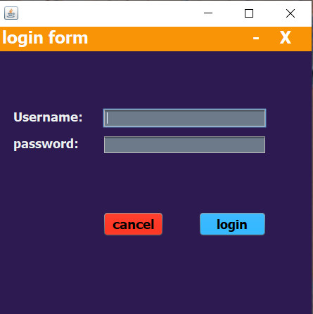
The Login G.U.I
This is the LOGIN G.U.I where the admin puts it’s name and it’s password to get into the main project where the main G.U.I is viewed and to make the admin search or insert a data to complete the details or some information about a user.
After putting password and username and click login you will be authorized to see the information of any student or professor signed in the system.

Slide 3
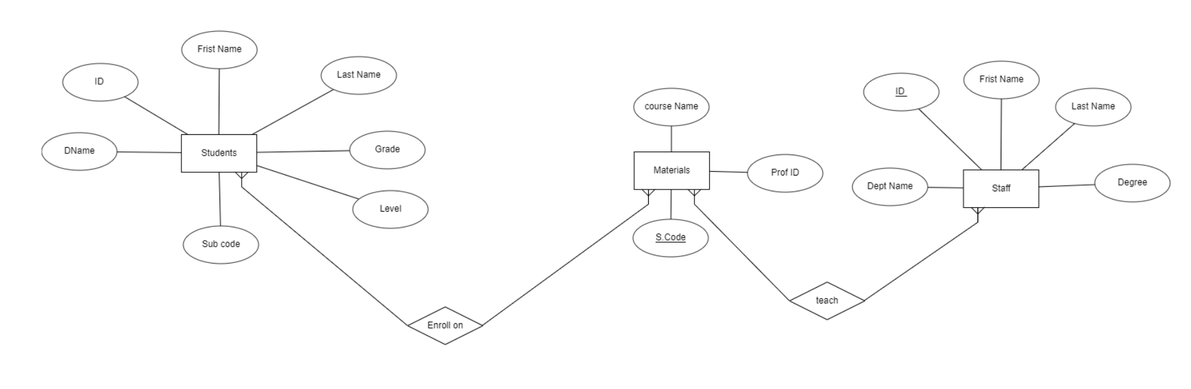
The E.R.D of the system
The E.R.D is the most important component between the components of the system .
Why are the E.R.D is the most important component??
Simply because it’s consider the base of the system where everything depends on from G.U.I to data base to the connection between them.

Slide 4
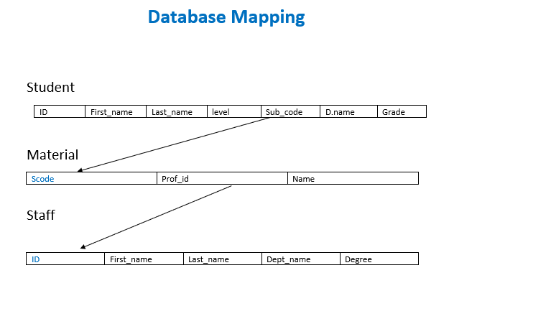
The Mapping.
The mapping always comes after the E.R.D as the mapping is like a clarification of the E.R.D and more understandable than E.R.D .
In the front pic we can see that the sub code connected to the other one in the second entity and the prof_id in the second entity is connected to the id in the third entity.

Slide 5

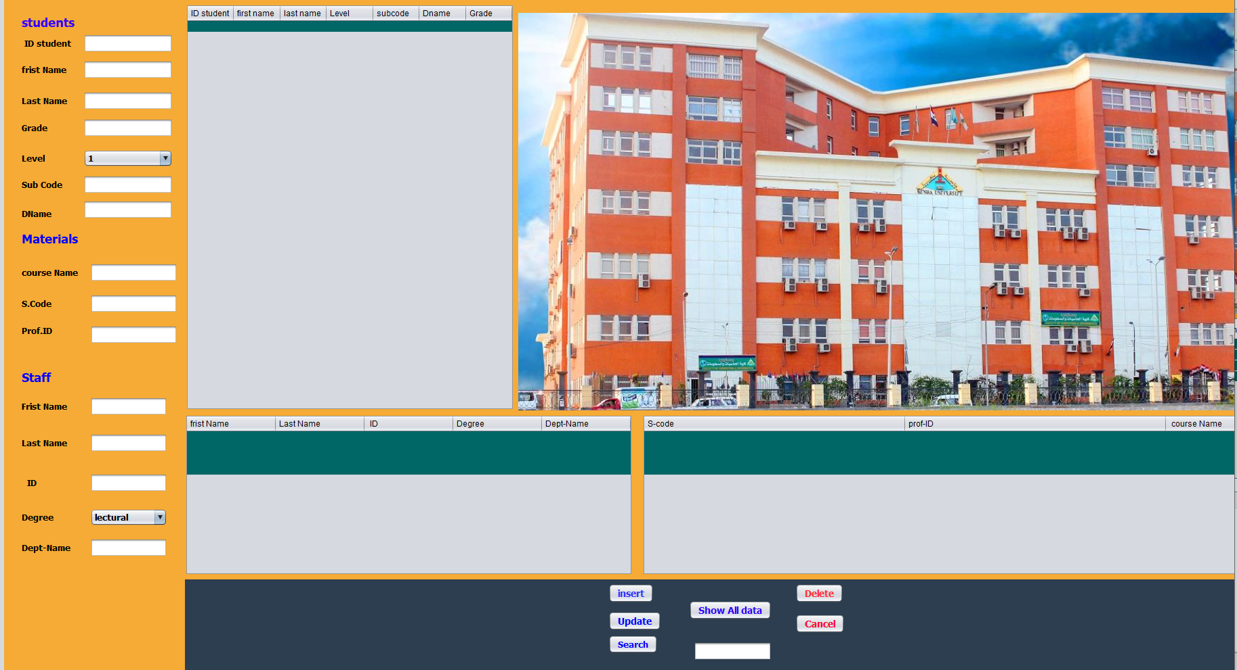
The Main G.U.I
This is the main G.U.I where the user or the admin complete the information in it and to know any information he want to know about any one works in the faculty.
The admin can insert a new student info. or material or even staff info.
Like professor or professor assistant.
The admin can delete or also update the info. Of the students or materials to not make them assigned in the system anymore.

Slide 6
Thanks

